Slide 1
Emotional Catalysts and Dynamic Networks: A Computational Analysis of Mobilization in Digital Activism
Huanrui CHEN, MACSS student
MA thesis advisor: Zhao Wang (and Hongbo Fang)
1

Slide 2
Digital activism today…
Social movements stem from deep structural inequalities or value conflicts.
These tensions often remain latent online, until a “focusing event” triggers public response.
What role do these unexpected, emotionally charged events play?
2

Slide 3
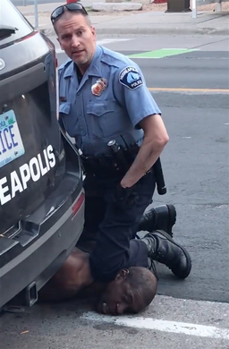
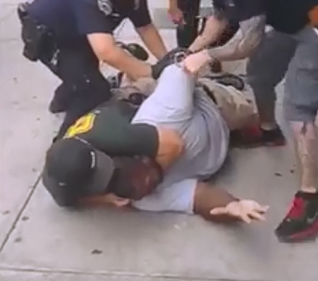
Black Lives Matter (BLM) movement
2013~now
2013: killing of Trayvon Martin, created by activists Alicia Garza, Patrisse Cullors, and Opal Tometi
2014: Michael Brown, Eric Garner
2020: The death of George Floyd (May 25th )
3

Slide 4
Data Collection
Dataset crawled from X (Twitter)
Key Event: George Floyd’s death – May 25, 2020
Timeframe: May 2019 – May 2021
Hashtags: #BLM #BlackLivesMatter
141,319 original tweets (Before: 9K → After: 132K)
5.86M total retweets (Before:233K → After: 5.63M)
2.33M unique users
4

Slide 5
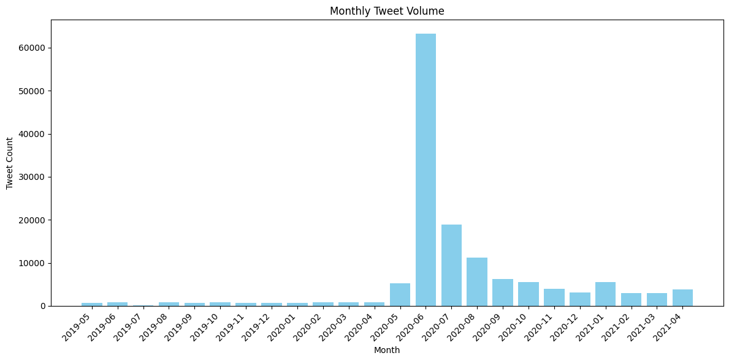
Tweet related with BLM spiked in June 2020 following George Floyd’s death.
5

Slide 6
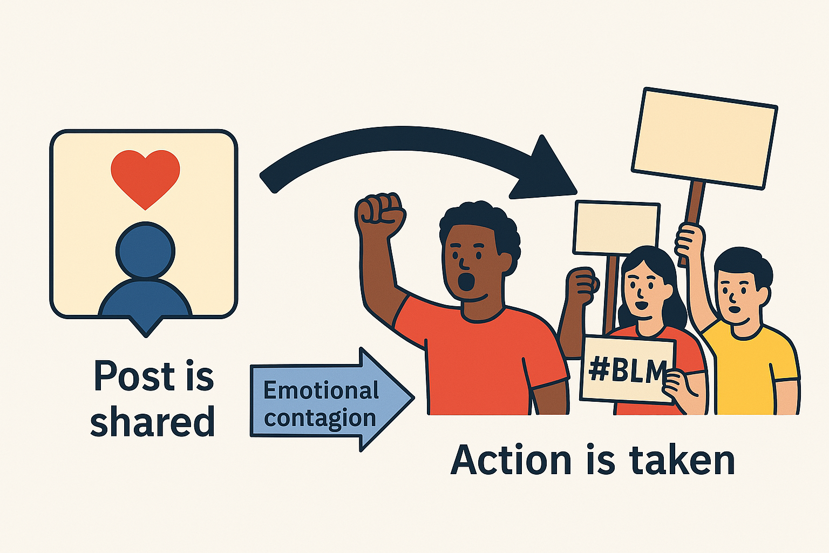
Research Question 1:
What role does emotion play before and after the ‘Murder of George Floyd’ event?
• Emotion can drive attention, sharing, and mobilization.
• This protest included tweets with diverse emotional types and intensities.
6

Slide 7
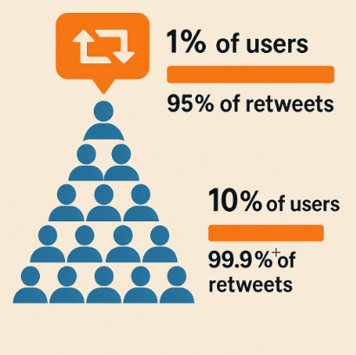
Research Question 2:
How does the network structure change in online mobilization before and after a focusing event?
• Tweets and retweets form a visible, connected network, not isolated data points.
• After the event, the majority of retweets occurred on posts by a small number of users, indicating a highly concentrated pattern of retweeting.
7

Slide 8
Question 1: What role does emotion play before and after the ‘Murder of George Floyd’ event?
Definite emotion and intensity:
Emotion classification based on the six basic emotions theory (Ekman, 1992): Joy, sadness, anger, fear, disgust, surprise.
Emotion intensity scored 0–1. The emotion that has highest intensity is the “dominant emotion” of the post.
Annotated using LLM (DeepSeek-V3), then manually verified with ~87% accuracy
8

Slide 9
Question 1: What role does emotion-intensity play before and after the ‘Murder of George Floyd’ incident?
DeepSeek-V3 Prompt:
"Analyze the following tweet text using Ekman's six basic emotions model (anger, disgust, fear, joy, sadness, surprise) and their intensities, and identify the framing strategy.
Classify each emotion with a 0.0-1.0 scale:
0.0 = none
0.1–0.3 = mild
0.4–0.6 = moderate
0.7–0.9 = strong
1.0 = extreme
Example:... “
OpenAI. (2023). Best practices for prompt engineering with the OpenAI API
9

Slide 10
Question 1: What role does emotion-intensity play before and after the ‘Murder of George Floyd’ incident?
Example…
Content: "In Louisville, Black Lives Matter organization is purchasing vacant homes for low-income families to promote stability in the community and fight gentrification."
Emotion Analysis:
Anger: 0.0
Disgust: 0.0
Fear: 0.0
Joy: 0.7
Sadness: 0.0
Surprise: 0.3
Dominant Emotion: Joy
10

Slide 11
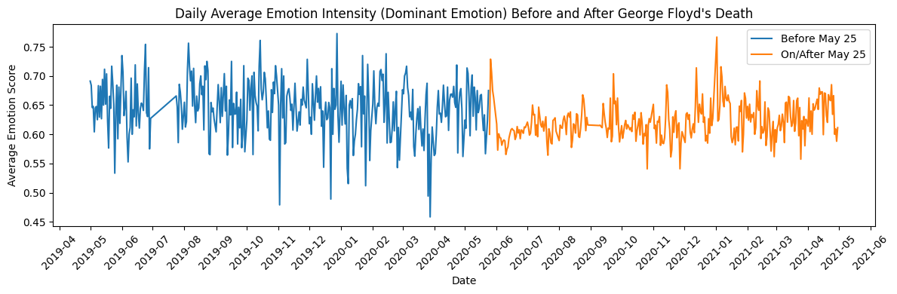
Distribution of average emotion intensity
Prior to the event, there was larger variance of emotion intensity and more days with lower levels.
11

Slide 12
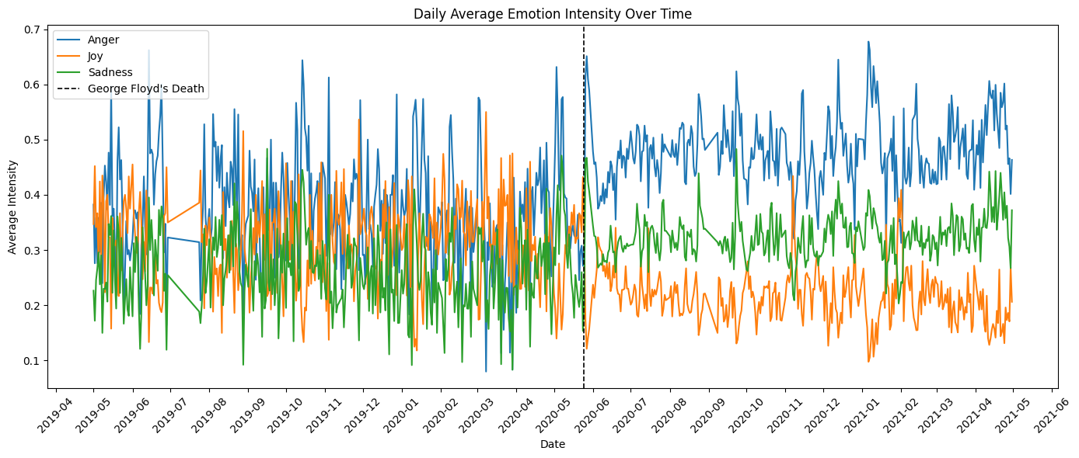
Difference in emotional intensity before and after the event
Before the event, anger, joy, and sadness had similar and overlapping intensity levels.
Afterward, they diverged sharply.
12

Slide 13
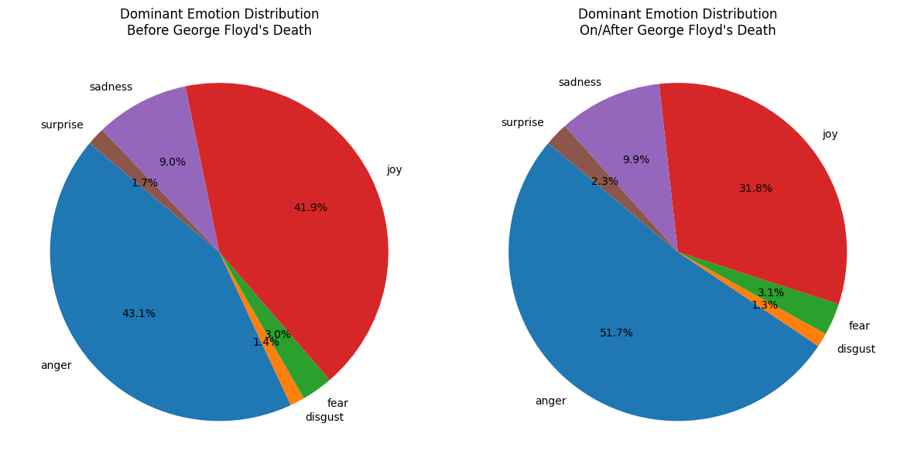
Difference in emotion distribution before and after the event
After the event, anger and sadness became more dominant while joy declined, highlighting a shift in expressions.
13

Slide 14
But...Why does “Joy” take up such a large part?
Text: The maker of "Call of Duty: Modern Warfare" has added a screen to the shooter game supporting the Black Lives Matter movement, after revealing that it is banning thousands of racist player names every day. https://t.co/OIqfSNFYVZ
Emotion: Joy (0.6)
Text: We’re doing a Tooting Black Pound Day Trail of local #Tooting businesses on Saturday 5th September, ending up at a Community Event/Trade Fair to promote Black Businesses who don’t have premises. 🙏🏽 You’re welcome to come and join us to support our community! 🙏🏽❤️ #BLM
Emotion: Joy (0.7)
Joy is often associated with promotion and motivational discourse in social mobilization.
14

Slide 15
Political Mobilization Frameworks
Motivational, Diagnostic, and Prognostic Frames (Snow & Benford, 1988)
Motivational Frame: Issues an emotional or moral call to action. It mobilizes participants by stressing the urgency and necessity of collective action. Example: "We must stand up now to defend our rights."
Diagnostic Frame: Identifies and attributes the social problem. It defines what is wrong and who or what is responsible. Example: "Police use excessive force against marginalized communities."
Prognostic Frame: Proposes strategies or solutions to address the problem. It outlines what actions should be taken and by whom. Example: "We need legal reforms to ensure police accountability."
In annotation, there is also a category for “irrelevant”(to political mobilization), for example:
"Michael B. Jordan is People's Sexiest Man Alive in 2020! 😮 The actor is known for starring in 'Black Panther' and 'Creed,' and for actively supporting the Black Lives Matter movement."
15

Slide 16
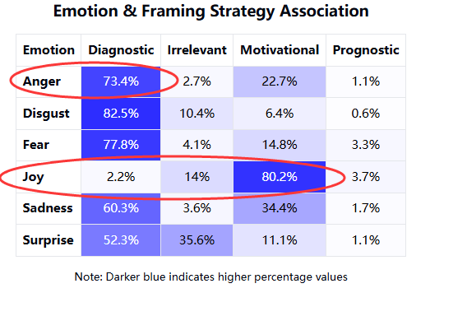
The heat map provides an interesting depiction for this part:
Joy is primarily associated with motivational framing.
Other emotions are predominantly associated with diagnostic framing.
16

Slide 17
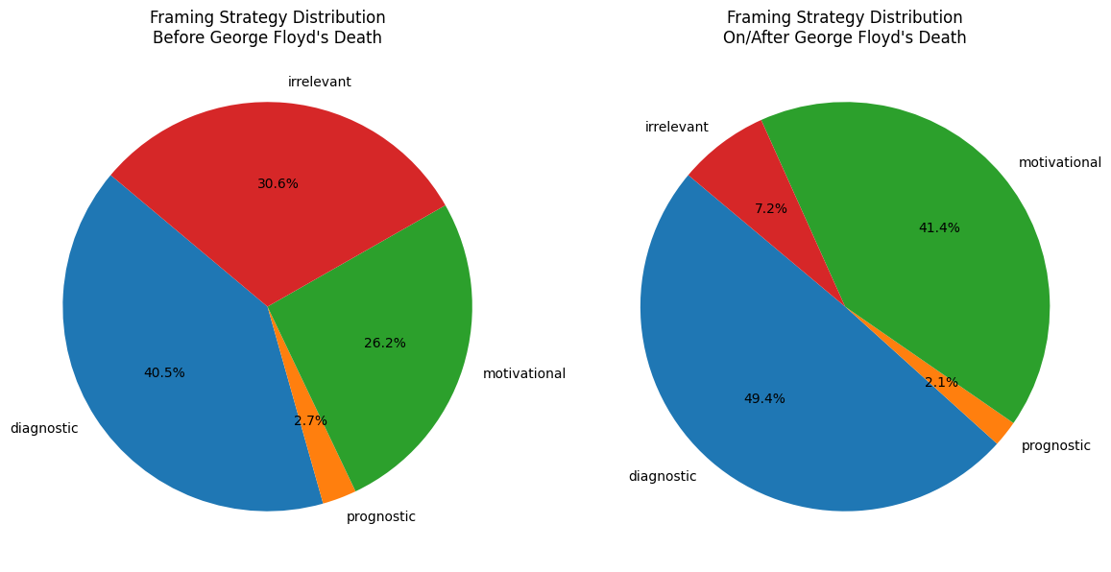
Difference in Political Mobilization Frame distribution before and after the event
After the event:
diagnostic and motivational framing increased
irrelevant content decreased
solution-oriented discourse remained minimal
17

Slide 18
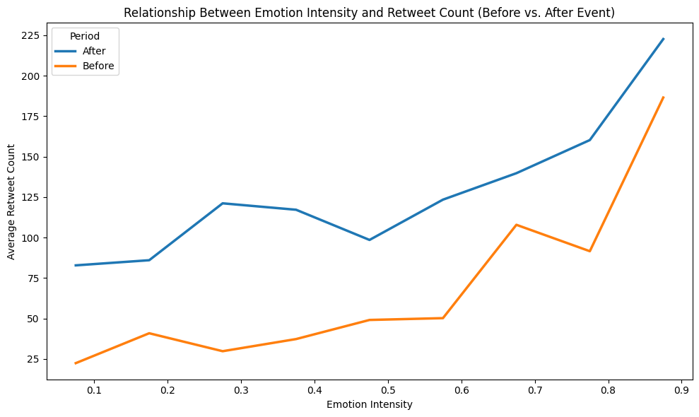
Difference in the relationship between emotional intensity and retweet before and after the event
After the event, the same level of emotion intensity has higher sharing rates, indicating that retweets become more sensitive to emotional intensity.
18

Slide 19
RQ1: What role does emotion-intensity play before and after the ‘Murder of George Floyd’ incident?
Anger and sadness increased while joy declined, marking a shift toward emotions.
Emotional intensity showed greater variance after the event, with this divergence linked to emotion type.
There is a positive correlation between emotional intensity and retweet count. Given the same emotional intensity, post-event tweets received more retweets than pre-event ones, indicating increased sensitivity to emotion.
Diagnostic and motivational framings both increased after the event, while irrelevant content dropped sharply and prognostic framing remained consistently low.
19

Slide 20
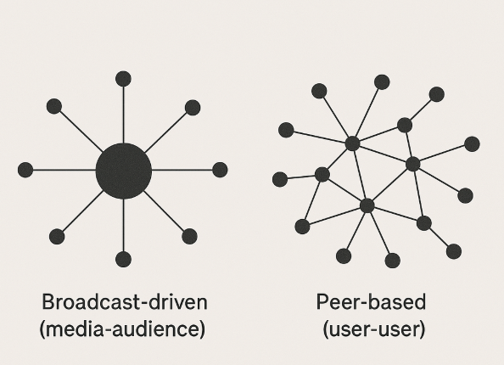
Question 2: How does network structure influence the reach and shape of online mobilization?
The Users networks:
Nodes: Individual users.
Edges: Retweet activity between users Direction: retweeter → original poster
Is mobilization broadcast-driven or peer-based ?
20

Slide 21
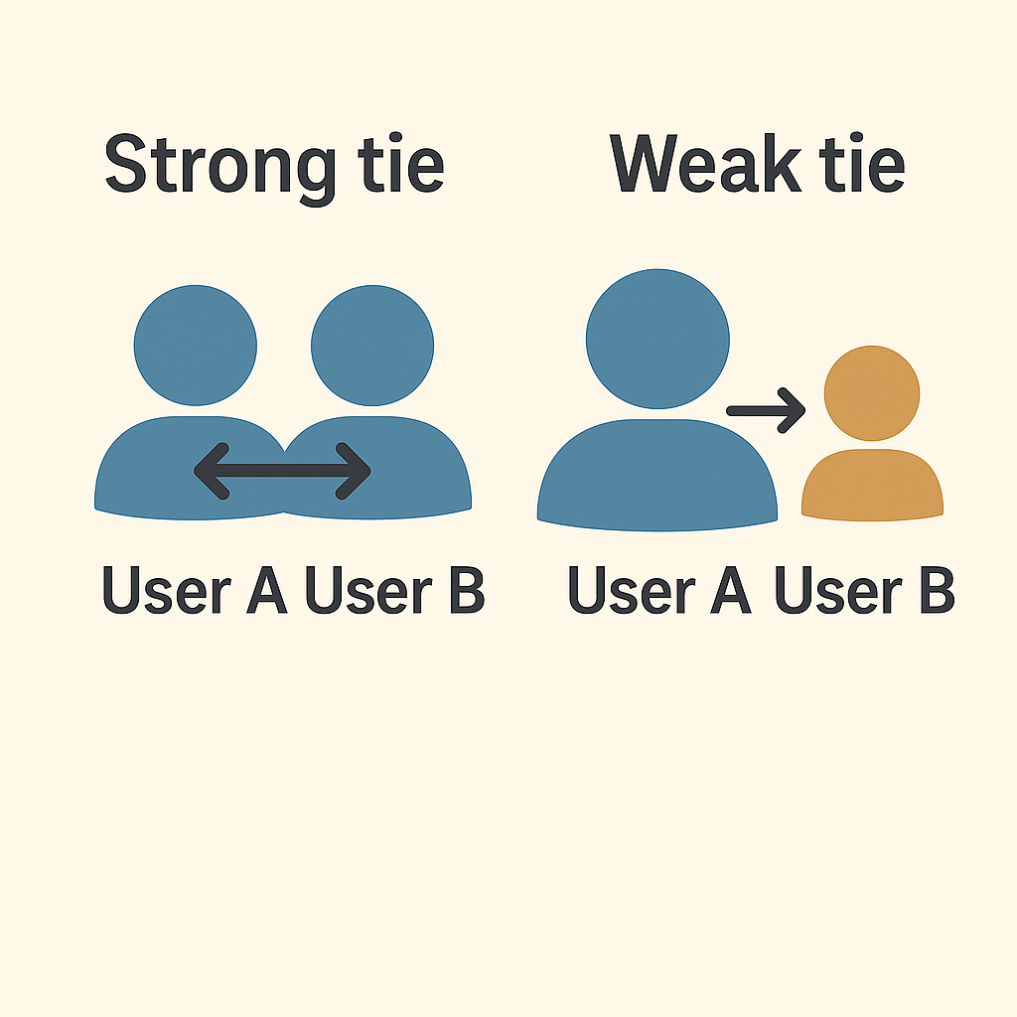
Strong and Weak ties in the Retweet Network
Strong tie connection:
mutual retweet relationships (User A ↔ User B)
Weak tie connection:
one-way retweet only (User A → User B)
21

Slide 22
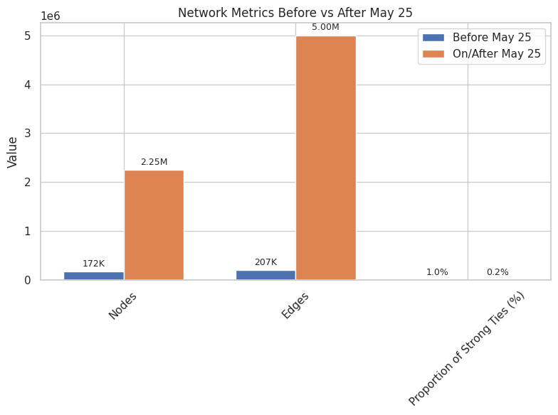
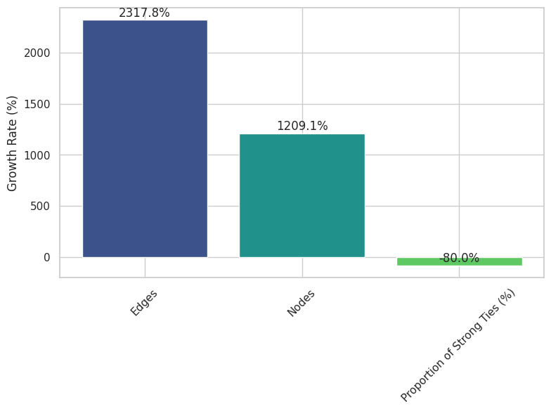
Network structure difference before and after the event
After the event, strong ties declined sharply, suggesting a shift toward a more broadcast-oriented network.
22

Slide 23
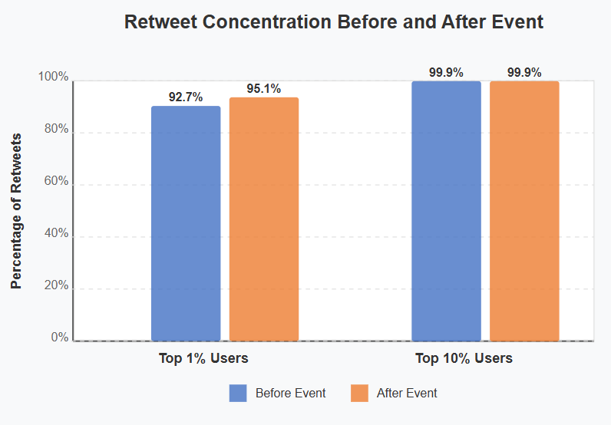
Network structure difference before and after the event
Small number of users receive the most attention, this became even more significant after the event.
23

Slide 24
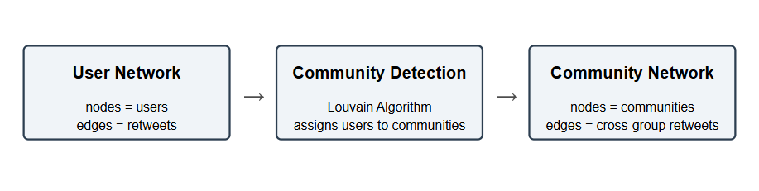
From user network to community network
User-level analysis highlights changes in network interaction types, but misses how groups interact.
Prior studies suggest cross-group diffusion is important to large-scale mobilization.
→ Further discussion on the community network
24

Slide 25
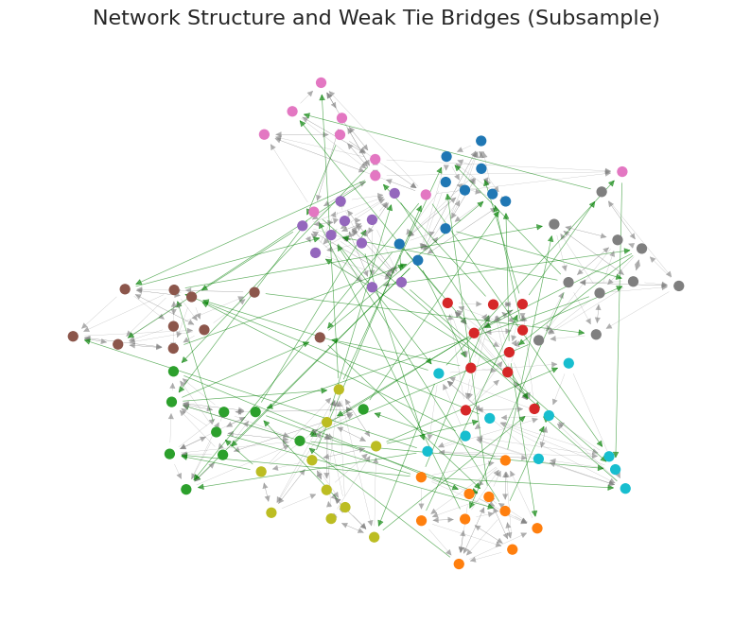
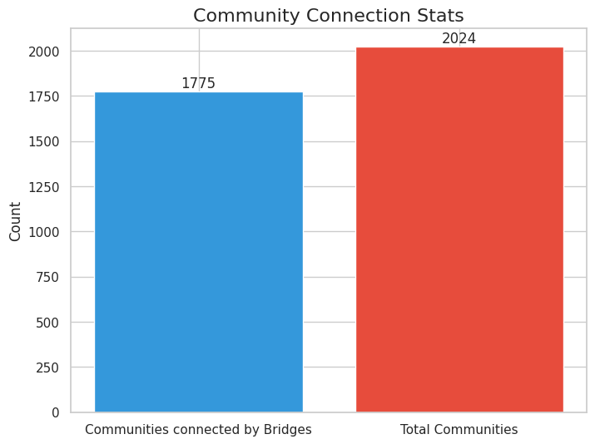
The community network
Retweets act as bridges between otherwise disconnected communities. If a edges occurs within the community, it is not a bridge.
These links break structural isolation and enable cross-group diffusion. The vast majority of communities are connected.
25

Slide 26
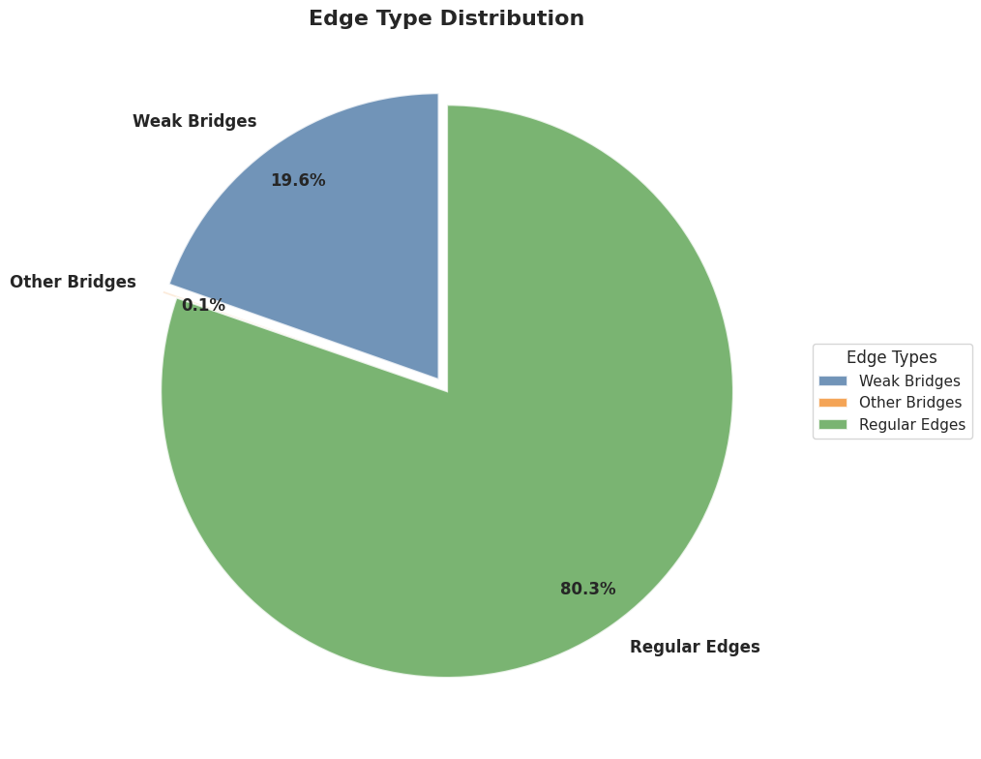
The community network
Most cross-community bridges are weak (one-way) ties.
26

Slide 27
RQ2: How does the network structure change in online mobilization before and after a focusing event?
The network grew dramatically after the event.
A broadcast-style pattern dominated the network throughout, and intensified after the event.
Weak, one-way ties became the main bridges connecting communities and breaking isolation.
*broadcast-style: Small number of users receive the most attention and spread the information through weak ties.
27

Slide 28
Summary and Hypothesis(need to be tested further)
How can this structural change be used to explain the spread of information?
1. New Users Enter the Discussion
The event triggered strong emotional reactions around social justice issues.
New users, unlike more experienced users engaging with hashtags like #BLM, were less informed about social injustice.
2. Trending and Recommendation Systems Amplify Central Voices
Platforms may amplify intense content
New users followed central voices, not peers.
Weak ties enabled fast, cross-community spread.
28

Slide 29
Next steps
29

Slide 30
Next steps: Multiple focusing event interruptions
Additional potential emotional intense events…
Murder of George Floyd’ event
Multiple focusing events occur in a digital movement, they will be used to explore how these events influence people's reactions to emotional intensity in online discourse, as well as their impact on social network structure.
30

Slide 31
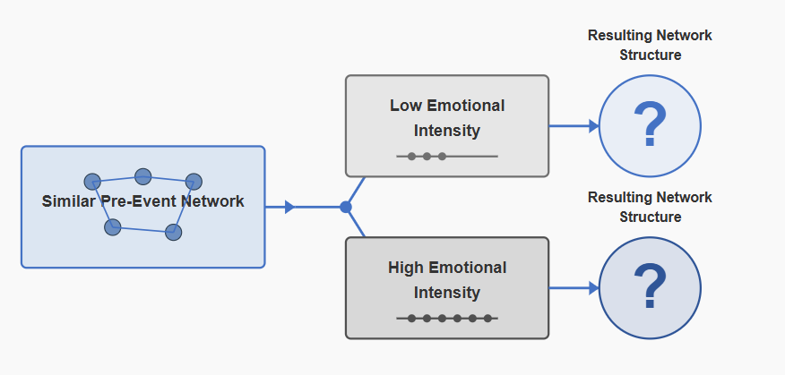
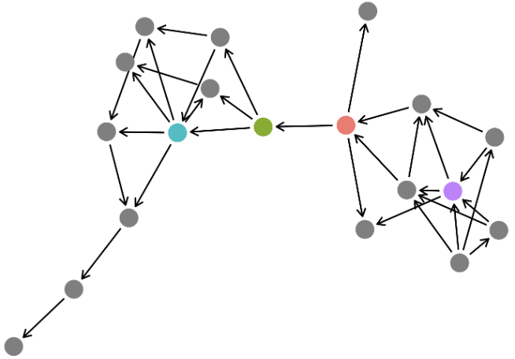
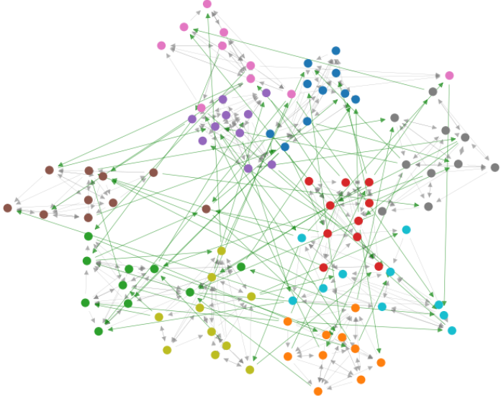
Next steps: Matching to Create Treatment and Control Groups
Match events with similar pre-event network structures for comparability.
Focusing event as treatment
How does the network change differently for cases with versus without a focusing event?
31
Notes:
Focus on shocking events and their emotional intensity.

Slide 32
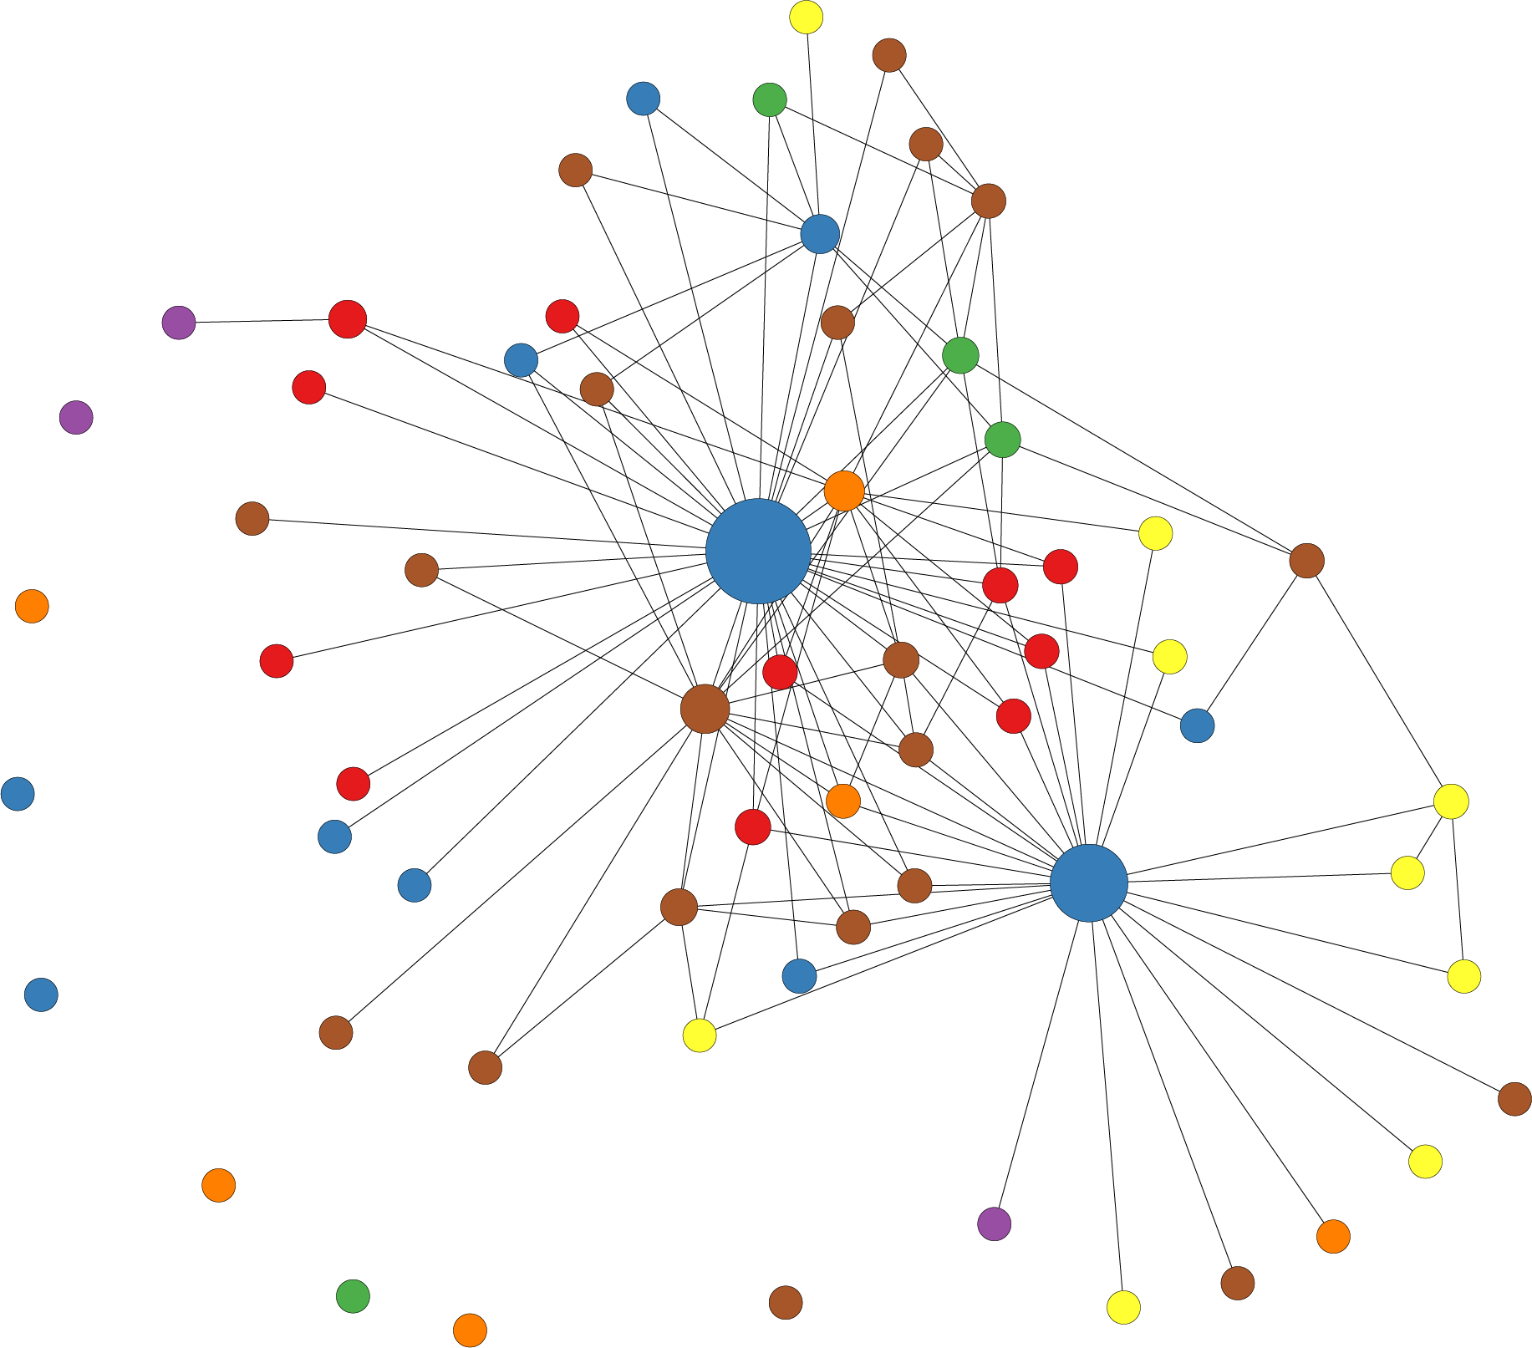
Causal Estimation + Time Series Analysis
social network evolution and information diffusion under high emotionally intensive events
…

Slide 33
Thank You！
If you have any further questions, feel free to reach out: hchen0628@uchicago.edu
32

